Slide 1
Neural Network Basics
Perceptron and other animal species

Slide 2

About Artificial Intelligence
AI is not only Neural networks
Other techniques like:
Search algorithms (DFS, BFS, A*)
Decision tree
Neural Networks
etc

Slide 3
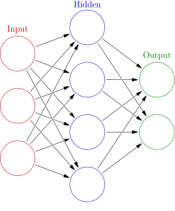
What is the neural network
Neurons which connected to each other
Columns are the layers
Hidden layer can called as deep layer (deep learning)
Hidden layer can have more than one

Slide 4
Neuron types
Rosenblatt Perceptron
Adeline
Linear neurons (linear perceptron)
Processing element with sigmoid output
etc

Slide 5
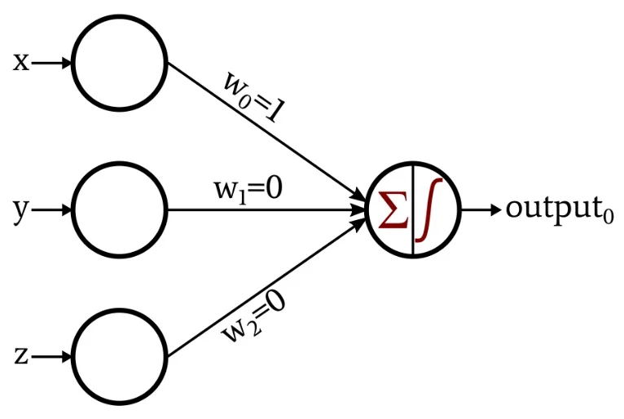
Perceptron
Input data
Weights
Sum of the multiplication data and weights
Activation function
Bias is a value which corrects

Slide 6
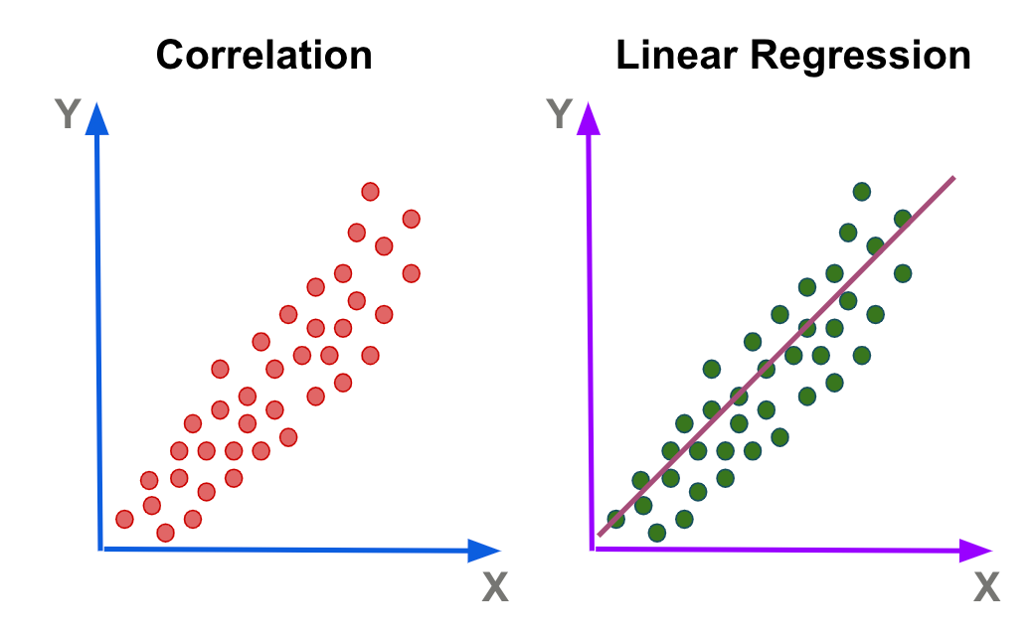
What can we do with it
Lineal regression
Classification

Slide 7
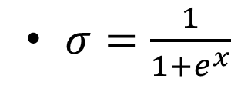
Activation function
The activation function of a node in an artificial neural network is a function that calculates the output of the node based on its individual inputs and their weights
Sigmoid function
https://en.wikipedia.org/wiki/Activation_function

Slide 8
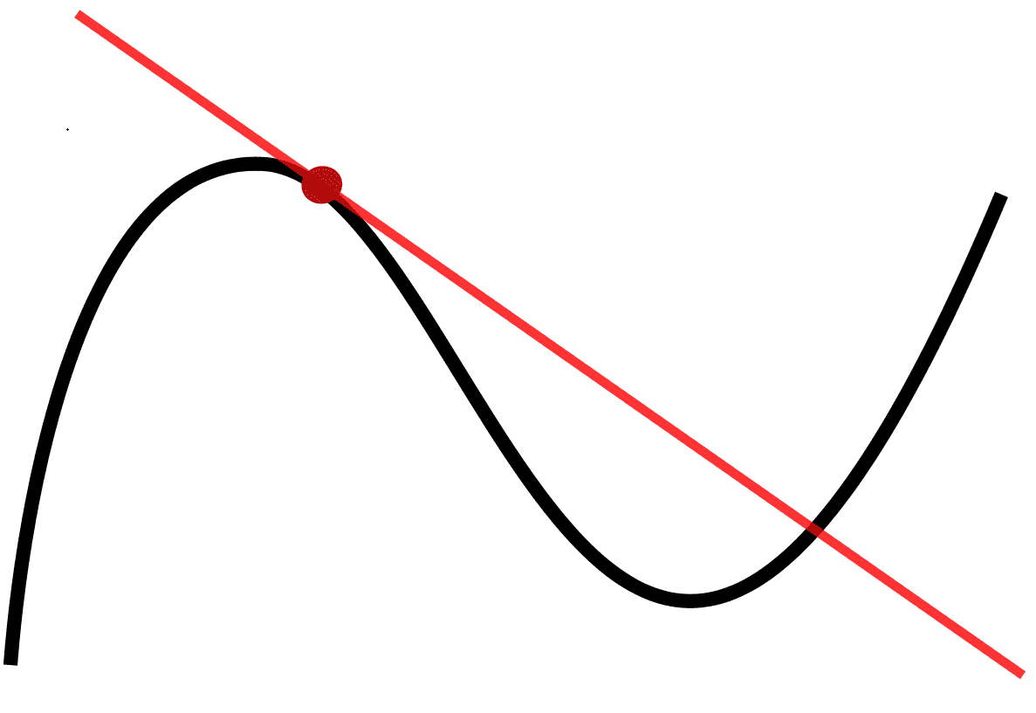
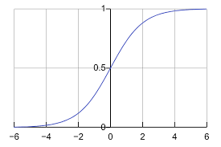
Learning
What is error?
How can we locate the minimum point?
What is local and global minimum?

Slide 9
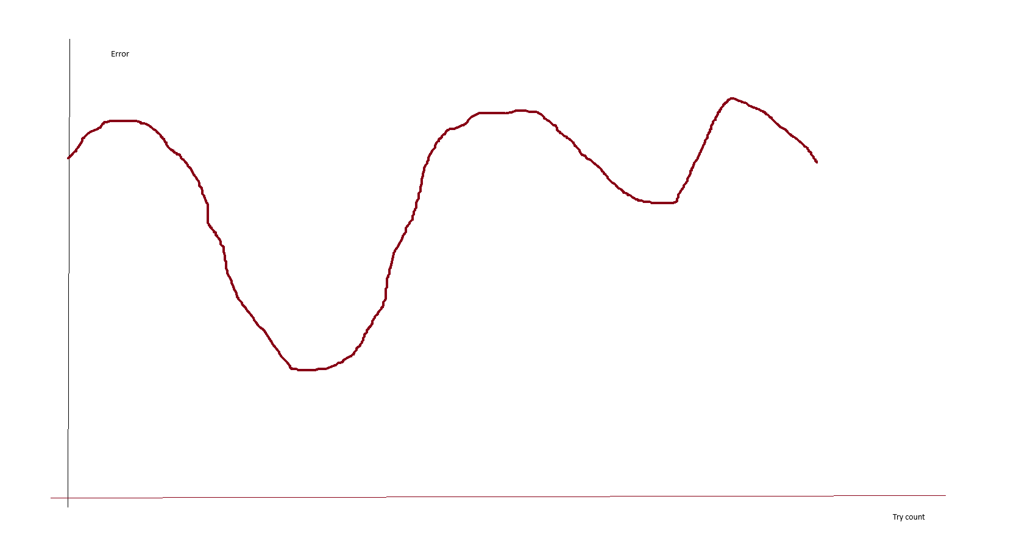
Learning curve

Slide 10
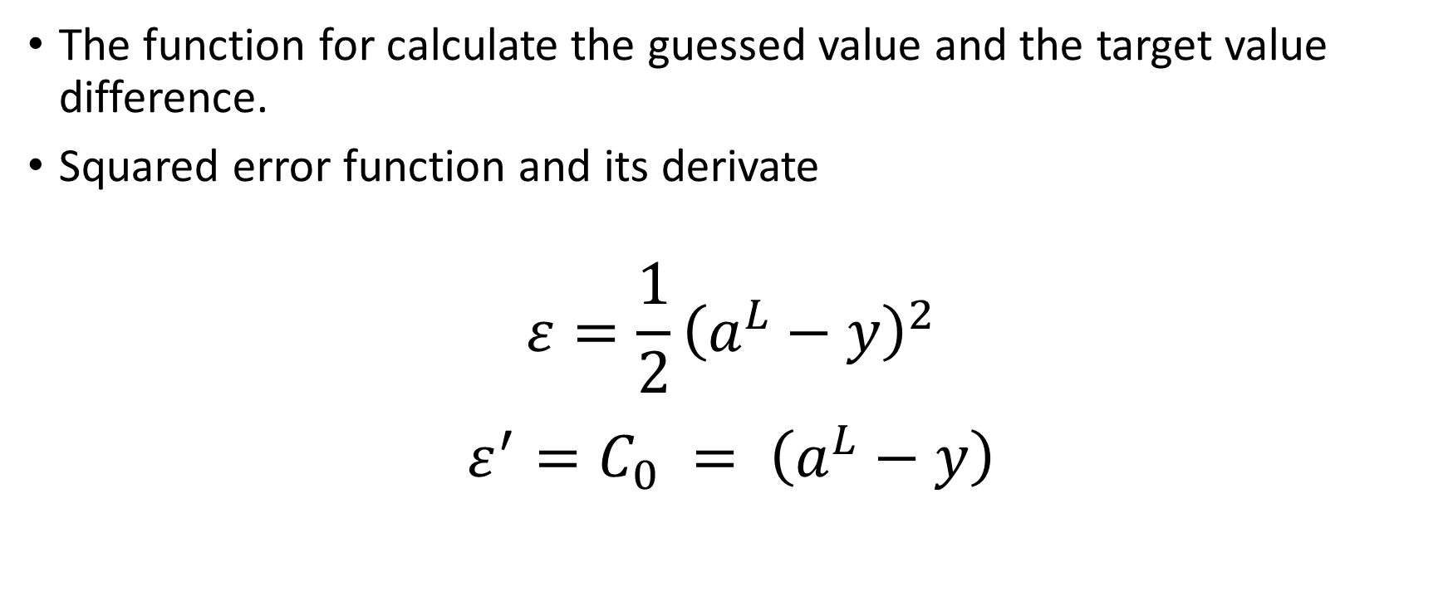
Error functions
The function for calculate the guessed value and the target value difference.
Squared error function and its derivate
$$ε=\frac{1}{2}{\left(a^{L}−y\right)}^{2}$$
$${ε^{′}=C}_{0} = \left(a^{L}−y\right)$$

Slide 11
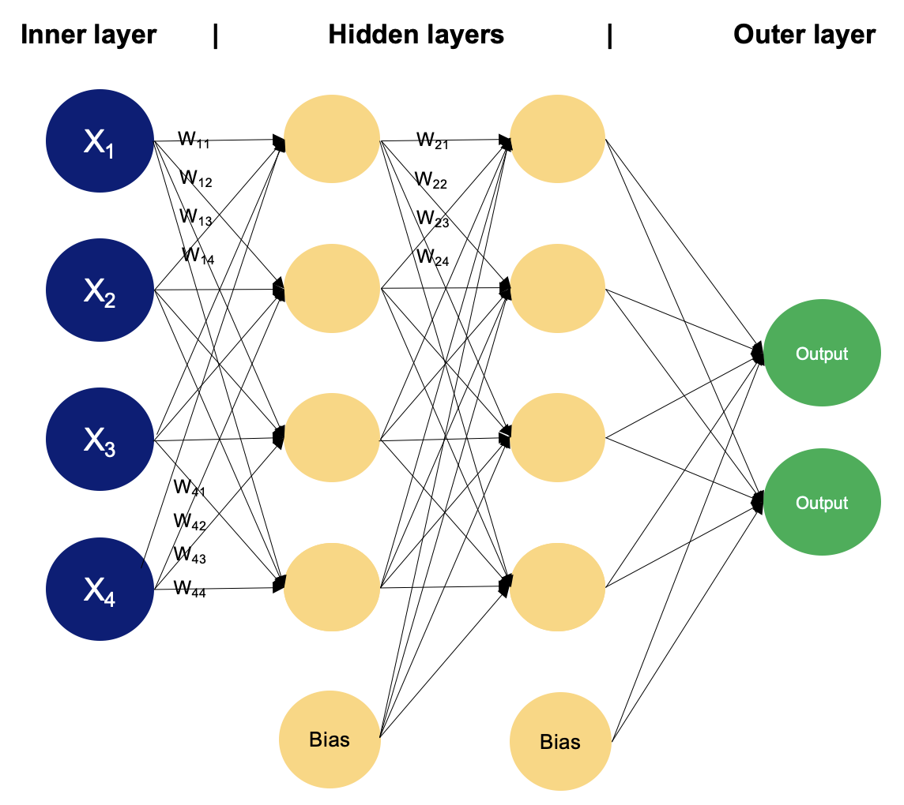
Multilayer perceptrons
Input layer (can be tricky)
Hidden layer (deep layer)
Output layer

Slide 12
How can we use this
We need dataset (huge amount of data)
Separate into 3 parts (learning, testing, using)
How do I solve when there is no numerical data?
Make a loop where give a data row to the network
The network will give a guess
Calculate the error rate
Calculate weights
Try again

Slide 13
Back propagation method
Don't panic, take a deep breath, relax.
We will derive.
https://www.mateking.hu/
https://www.wolframalpha.com/calculators/derivative-calculator/

Slide 14

Perceptron
Multiplied sum of the weights and inputs $z^{L}= w^{L}a^{L−1}+b^{L}$
Output $a^{L}=σ\left(z^{L}\right)$
Activation and its derivate $σ=\frac{1}{1+e^{x}}$
$$σ^{′}=1−x$$

Slide 15

The weights calculation partial derivates
$$\frac{∂C_{0}}{∂w^{L}}= \frac{∂z^{L}}{∂w^{L}} \frac{∂a^{L}}{∂z^{L}} \frac{∂C_{0}}{∂a^{L}}$$
$$\frac{∂C_{0}}{∂a^{L}}=2\left(a^{L}−y\right)$$
$$\frac{∂a^{L}}{∂z^{L}}=σ′(z^{L})$$
$$\frac{∂z^{L}}{∂w^{L}}=a^{L−1}$$

Slide 16

The values referred to error
$$\frac{∂C_{0}}{∂w^{L}}= \frac{∂z^{L}}{∂w^{L}} \frac{∂a^{L}}{∂z^{L}} \frac{∂C_{0}}{∂a^{L}}= a^{L−1 }σ^{′}\left(z^{L}\right)\left(a^{L}−y\right)$$
$$\frac{∂C_{0}}{∂b^{L}}= \frac{∂z^{L}}{∂b^{L}} \frac{∂a^{L}}{∂z^{L}} \frac{∂C_{0}}{∂a^{L}}=1σ^{′}\left(z^{L}\right)\left(a^{L}−y\right)$$
$$δ^{L}=σ\left(z^{L}\right)\sum{w^{L+1}δ^{L+1}}$$

Slide 17

Next time we will create a perceptron

